Slide 1
Talent for Turnaround Leadership Academy (T4TLA) Orientation “Primer” for New Members
Notes:
Mary
Welcome to the Talent for Turnaround Leadership Academy (T4TLA) webinar — an orientation “primer” of sorts for people who are new to T4TLA .
The two overarching drivers of T4TLA are Equitable Access and School Improvement.
The Talent for Turnaround Leadership Academy (T4TLA) is a multiyear initiative designed to help states and districts link equitable access and school improvement efforts.
The T4TLA focuses on the development of innovative and bold talent management strategies that attract, support, and retain effective educators in the lowest performing, highest need schools and districts.
The Every Student Succeeds Act (ESSA) emphasizes coordination among and between federal programs, and the T4TLA provides an ideal opportunity to strengthen connections between talent management and school improvement systems at the state and local levels.

Slide 2
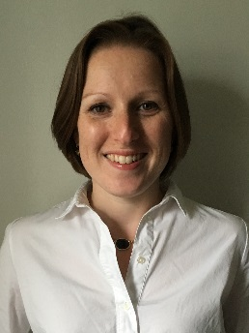
Welcome and Introductions
Dana Chambers
Center on Great Teachers & Leaders
Mary Peterson
West Comprehensive Center & The Center on School Turnaround
Notes:
Mary:
Facilitators for today’s webinar are:
Dana Chambers: Deputy Director at the GTL Center; and
Me: Mary Peterson, Senior Program Associate in WestEd’s Center for School Turnaround and West Comprehensive Center (CC).
We have multiple partners:
The Center on Great Teachers and Leaders (GTL);
The Northeast Comprehensive Center (NCC);
The Center on School Turnaround; and
The West Comprehensive Center (WCC).
We are pleased that you are joining us in this exciting opportunity.

Slide 3
Session Objectives and Agenda
Build a shared understanding of T4TLA for new cohort members.
What is T4TLA?
What has been the impact of T4TLA so far?
What are the roles and expectations of T4TLA teams and supporting organizations?
What are the next steps for new T4TLA members?
Notes:
Mary

Slide 4
What is the Talent for Turnaround Leadership Academy?
Notes:
Mary

Slide 5
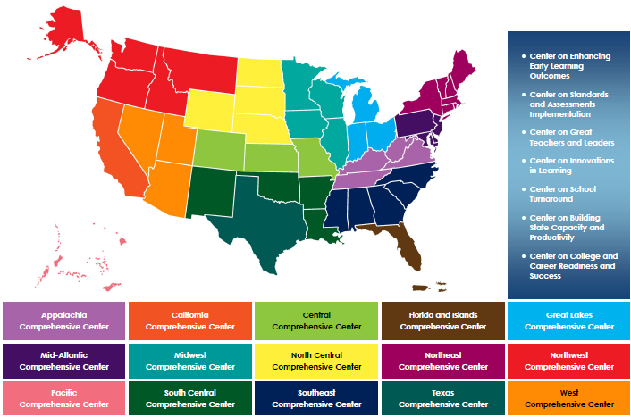
Comprehensive Centers Program 2012–19 Award Cycle
Notes:
Mary
We support the 12 regional comprehensive centers shown here as a part of the 7 content centers funded by the US Department of Education.
One strand of this work that is recently emerging as one of great interest from many states is one focused on mentoring and induction.

Slide 6
Collaborating Across the Comprehensive Center Network: The Evolution of the T4T Initiative
Communicated vision
Assessed readiness
Recruited cohort 1
Initial T4T National Conference
June 2016
Fall 2016
Summer 2016
December 2016
Formed partnership
Developed theory of action (ToA) and concept paper
Hosted National Meeting 1: Data Review, Root Cause Analysis, Strategy Selection
Notes:
Mary
The opportunity to design the T4TLA grew out of a June…….
Staff from the GTL Center, Center for School Turnaround, NCC and West CC met to consider how we could help states address the challenges they face in ensuring high-needs schools have the talent they need to help all students success in turnaround settings.
We formed and normed a partnership, developed the model for technical assistance (TA) that would support states and districts and developed a Theory of Action (ToA) (click hyperlink).
We reached out the Regional Centers serving states across the country to inform them of the opportunity and to invite states in their regions to participate. Interested states were assisted in understanding the commitment required and then were assisted to assess their capacity and readiness for the work.
We then got to work to design and convene the launch of the T4TLA at the first national meeting in December 2016.

Slide 7
If we want to ensure that students in our lowest performing schools are taught by effective teachers in schools with effective leaders,
Then we need systems for attracting, supporting, and retaining educators with the knowledge and skills required to turn around low-performing schools.
Notes:
Mary
There is an Inextricable Link Between Strong Educators and Strong Systems:
If we put strong educators into weak systems, the system wins every time.
If we put strong educators into strong systems, the educators and the systems continue to improve.
This work originated based on a few key ideas:
Equity and school improvement are a tight fit — both are based on the premise that by establishing a stronger and more coherent educator talent pipeline, we will improve outcomes in our highest need schools.
Through this work, we emphasize that cross-departmental alignment and collaboration is key — a systemic approach always outperforms work that is done in siloes.
We model this collaboration through our center network — this collaboration serves as an example of how we can leverage the expertise and resources of a vast network of CCs to improve outcomes for states.

Slide 8
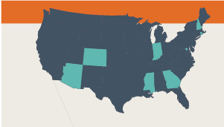
Notes:
Mary

Slide 9
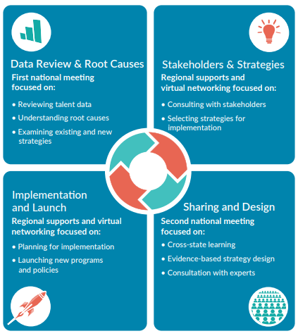
The T4TLA Approach
Notes:
Mary
Overview of our TA approach from Meeting 1 through Meeting 2 with interim Regional Center (RC) support between meetings.

Slide 10
What did T4TLA teams learn from their data?
Notes:
Mary

Slide 11
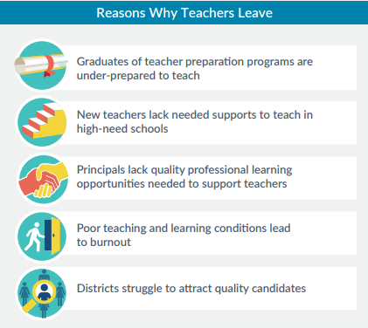
Why are schools in T4TLA districts struggling with retention?
Notes:
Mary

Slide 12
Collaborating Across the Comprehensive Center Network: The Evolution of the T4T Initiative
Interim technical assistance (TA) support from RCCs to design T4TLA strategies
Launch of Mentoring and Induction Affinity Group
Early 2017
Late 2017
May 2017
2018
National Meeting 2: Strategy implementation support
Ongoing TA support from regional center RCC leads
preparing for National Meeting 3
Notes:
Mary

Slide 13
What has been the impact so far of the T4TLA initiative?
Notes:
Dana

Slide 14
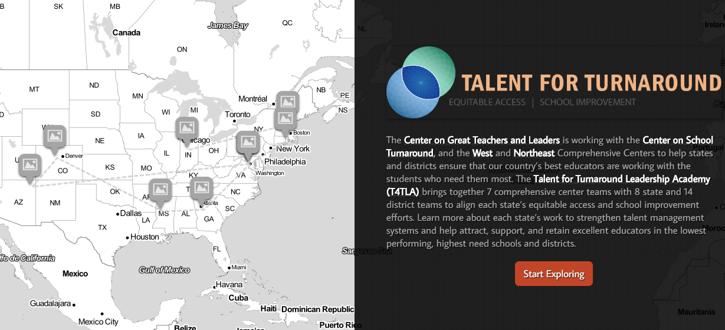
What progress have T4TLA teams made in implementing strategies to improve retention?
Notes:
Dana

Slide 15
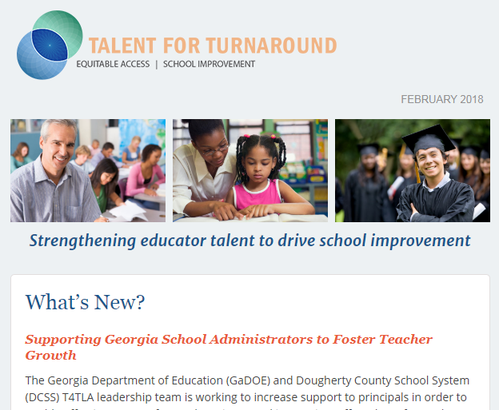
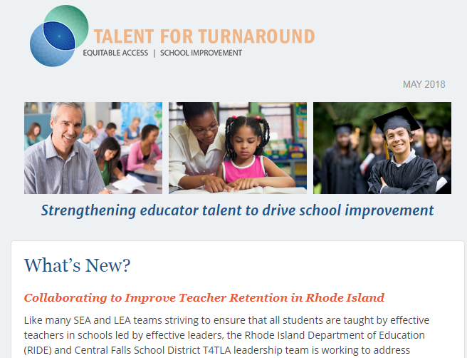
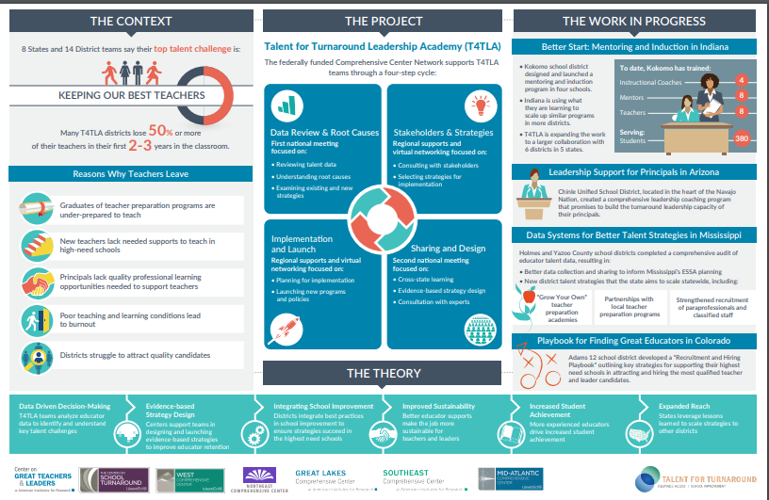
Telling the Story
Quarterly newsletters
Evidence of impact
Cross-center evaluations
The T4TLA story map and infographic
Notes:
Dana
Over the last year, we have worked to capture the amazing work happening across the cohort. If you haven’t seen it already, there is a wonderful story map on the GTL website (hyperlink) that features the work of the teams and the results they are achieving.
Just a couple of examples:
(1) Indiana has identified four additional districts to scale their M&I efforts, leveraging their learning with the work done in Kokomo through T4TLA. To support this work, they have developed a Moodle platform for the four districts to complete assignments as well as an M&I handbook template districts will use to build out their own M&I handbooks based on the activities provided in the scale up. Kokomo’s handbook has been used as a model for the new districts to use.
(2) In Rhode Island, they are underway in the implementation of a Comprehensive Induction Program designed through T4TLA. The RIDE-CFSD team is now working on a strategy to develop a leadership framework aligned to the district’s Blueprint for Equity, Empowerment, and Excellence and that will lead to improved leader retention.
(3) In Y6, DC identified additional charter districts to include in their T4T supports and fold into their participation in the M&I affinity group work.
(4) Georgia has identified an additional district (Muscogee County) to scale their T4T efforts. GaDOE will support Muscogee in strengthening their M&I program to reflect the resources, knowledge, and capacity built through their participation in the M&I affinity group.
(5) In Y6, Mississippi onboarded two additional districts to scale their T4T supports beyond Yazoo and Quitman to Clarksdale and Greenwood districts. The state DOE continues to make progress with these districts and in developing guidance documents and aligning efforts at the state level for M&I.
(6) In Colorado, both Adams 12 and Huerfano have completed their original action plans. Adams 12 developed and implemented a "Recruitment and Hiring Playbook" for their Title I schools, modeled on the Playbook that Avalon School District shared at the 2nd T4TLA national meeting in Phoenix in May 2017.
(7) Chinle (AZ) continues to integrate leadership coaching into their local support for school leaders, facilitated by AIR leadership coaches on a monthly basis.

Slide 16
What are the roles and expectations of T4TLA teams and supporting organizations?
Notes:
Dana

Slide 17
T4TLA Cohort Today: 7 States and 15 Districts
Southeast CC
Northeast CC
Great Lakes CC
Mid-Atlantic CC
West CC
GA
MS
RI
IN
DC
CO
AZ
Dougherty
Clarksdale
Central Falls
Kokomo
Maya Angelou Charter Schools
Huerfano
Tucson
Yazoo
Adams
Leona
Friendship Public Schools
Globe
Quitman County
Chinle
Greenwood
Notes:
Dana
The cohort of SEAs and LEAs that began in 2016 has changed over time. Due to shifting priorities and capacities, IL and NH participated in the first year only. We have new district teams as well in MS and DC. The cohort today includes 7 states and 15 districts.

Slide 18
The Role of the RCC in T4TLA
Provide support for SEA and LEA teams during and after national meetings:
Review talent management data and strategic plans.
Explore root causes.
Design bold talent management strategies.
Align state- and district-level policies and systems to support implementation.
Provide ongoing implementation support.
Engage in needs sensing and ongoing planning.
Provide resources to participate in national and regional meetings.
Notes:
Dana

Slide 19
Expectations of SEAs in T4TLA
Establish a state team including school improvement and educator effectiveness staff.
Participate actively in national and regional meetings.
Provide technical assistance to partner districts during and between meetings to:
Review talent management data and strategic plans.
Explore root causes.
Design bold talent management strategies.
Navigate or eliminate state-level barriers to strategy implementation.
Leverage ESSA funding for strategy implementation.
Provide ongoing implementation support.
Notes:
Dana

Slide 20
Expectations of Districts in T4TLA
Establish a district team including school improvement and educator effectiveness staff.
Participate actively in national and regional meetings.
Collaborate with RCC and state partners at convenings and back at home to:
Review talent management data and strategic plans.
Explore root causes.
Design bold talent management strategies.
Align district-level talent management efforts to state priorities and current context.
Leverage ESSA funding for strategy implementation.
Collaborate with the state for strategy implementation.
Notes:
Dana

Slide 21
What are the next steps for new T4TLA teams?
Notes:
Mary

Slide 22
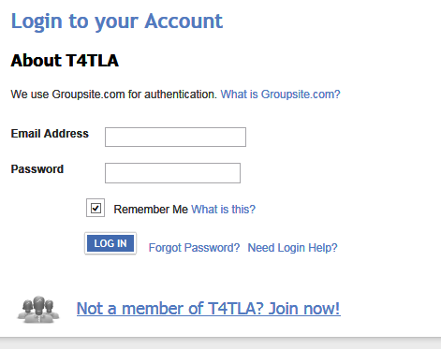
Join Our T4TLA Groupsite
Visit our T4TLA Groupsite for more information on the December meeting. http://T4TLA.groupsite.com
Request to “become a member” of the site.
Set up your profile.
Browse T4TLA and meeting materials. New information will be uploaded as we get closer to National Meeting 3.
Notes:
Mary
T4TLA uses a mobile site to provide key meeting materials and other resources.
The link is provided here – our conferences will largely be paperless, so you’ll want to become acquainted with the Groupsite.
If you click on the link, you will need to request to become a member to be granted access.
Then you can set up your profile that we will use throughout the year across regional and national meetings.
NOTE – PUSH OUT GROUPSITE LINK INTO THE CHAT BAR FOR PARTICIPANTS

Slide 23
Save the Date! T4TLA National Meeting 3
When: November 15–16, 2018
Where:
Hilton DoubleTree Crystal City, Washington, DC Metro Area
300 Army Navy Drive
Arlington, VA 22202-2891
Registration https://app.smartsheet.com/b/form/9ed2251fd8574246b09a3165b434bc32
Notes:
Mary

Slide 24
Explore Participation in Virtual CoP
Series of ~3 virtual CoP meetings for RC, SEA, LEA staff
Engage in problem solving consultancies
Learn from experts on prioritized topics
Connect with TA providers for support
Share resources from the field
Build community that can be sustained beyond 2019
Notes:
Mary

Slide 25
Dana Chambers Mary Peterson
dchambers@air.org mpeters@wested.org
202.403.6899 775.771.2867

